Slide 2
Chapter 1: Explore the Network
Introduction to Networks v6.0
Notes:
Cisco Networking Academy Program
Introduction to Networks v6.0
Chapter 1: Explore the Network

Slide 3
Chapter 1 - Sections & Objectives
1.1 Globally Connected
Explain how networks affect the way we interact, learn, work, and play.
Explain how host devices can be used as clients, servers, or both.
1.2 LANs, WANs, and the Internet
Explain the use of network devices.
Compare the devices and topologies of a LAN to the devices and topologies of a WAN.
Describe the basic structure of the Internet.
Explain how LANs and WANs interconnect to the Internet.
1.3 The Network as a Platform
Explain the concept of a converged network.
Describe the four basic requirements of a reliable network.
1.4 The Changing Network Environment
Explain how trends such as BYOD, online collaboration, video, and cloud computing are changing the way we interact.
Explain how networking technologies are changing the home environment.
Identify basic security threats and solutions for both small and large networks.
Describe the importance of understanding the underlying switching and routing infrastructure of a network.
Notes:
3

Slide 4
1.1 Globally Connected
Notes:
Cisco Networking Academy Program
Introduction to Networks v6.0
Chapter 1: Explore the Network

Slide 5
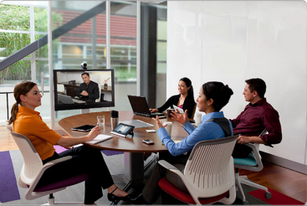
Globally Connected Networking Today
Network has no boundary and supports the way we:
Learn
Communicate
Work
Play
Notes:
1.1 – Globally Connected
1.1.1 – Network Today

Slide 6
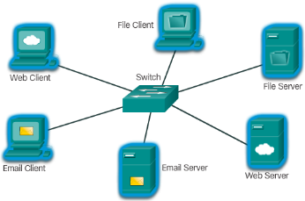
Globally Connected Providing Resources in a Network
Networks of Many Sizes
Small Home / Office Networks
Medium to Large Networks
World Wide Network
Clients and Servers
Clients request and display information
Servers provide information to other devices on the network
Peer-to-Peer
Computers can be both server and client at the same time.
What are the advantages?
What are the disadvantages?
Notes:
1.1 – Globally Connected
1.1.2 – Providing Resources in a Network

Slide 7
Globally Connected Networking Collaboration Tool – Class Activity
See the activity file on my website and listen for further instruction
Notes:
1.1 – Globally Connected
1.1.1 – Network Today

Slide 8
1.2 LANs, WANs, and the Internet
Notes:
Cisco Networking Academy Program
Introduction to Networks v6.0
Chapter 1: Explore the Network

Slide 9
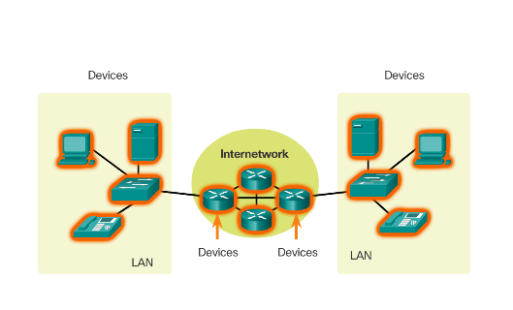
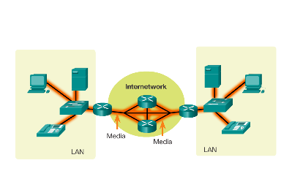
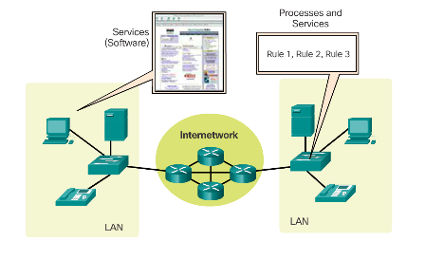
LANs, WANs, and the Internet Network Components
Devices
Services
Media
Notes:
1.2 – LANs, WANs, and the Internet
1.2.1 – Network Components

Slide 10
LANs, WANs, and the Internet Network Components
End Devices
Either the source or destination of a message transmitted over a network.
Notes:
1.2 – LANs, WANs, and the Internet
1.2.1 – Network Components

Slide 11
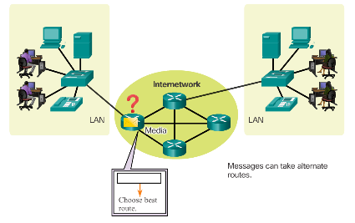
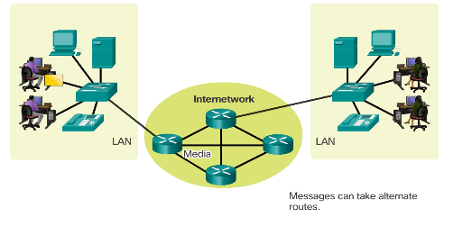
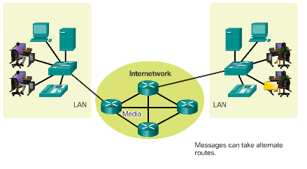
LANs, WANs, and the Internet Network Components
End Devices
Example of a message sent over a network.
Intermediary
Source
Destination
Notes:
1.2 – LANs, WANs, and the Internet
1.2.1 – Network Components

Slide 12
LANs, WANs, and the Internet Network Components
Intermediary Network Devices
Connect multiple individual networks to form an internetwork
Connect the individual end devices to the network
Ensure data flows across the network
Provide connectivity
Notes:
1.2 – LANs, WANs, and the Internet
1.2.1 – Network Components

Slide 13
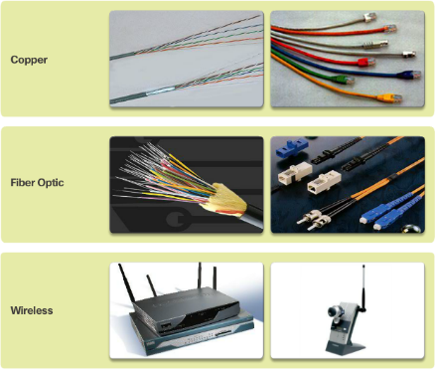
LANs, WANs, and the Internet Network Components
Network Media
Provide the pathway for data transmission
Interconnect devices
Name the three types of media
Notes:
1.2 – LANs, WANs, and the Internet
1.2.1 – Network Components

Slide 14
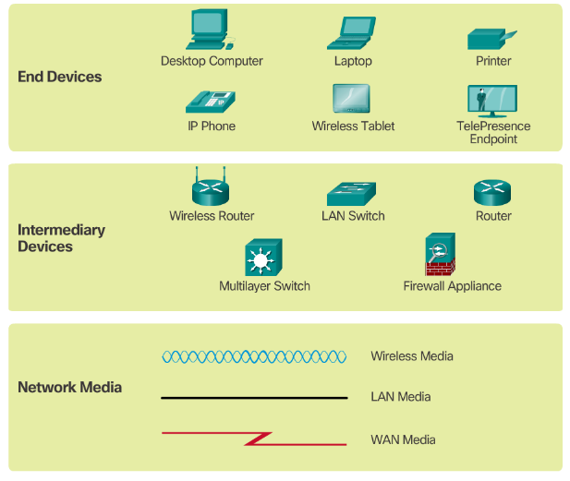
LANs, WANs, and the Internet Network Components
Network Representations
What do the symbols represent?
Notes:
1.2 – LANs, WANs, and the Internet
1.2.1 – Network Components

Slide 15
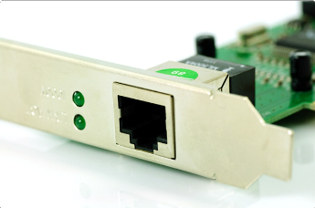
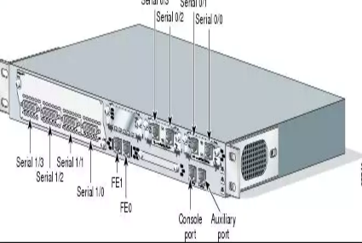
LANs, WANs, and the Internet Network Components
Specialized terminologies on devices connected in a network.
Network Interface Card - A NIC, or LAN adapter, provides the physical connection to the network at the PC or other end device. The media that are connecting the PC to the networking device, plug directly into the NIC.
Physical Port - A connector or outlet on a networking device where the media is connected to an end device or another networking device.
Interface - Specialized ports on a networking device that connect to individual networks. Because routers are used to interconnect networks, the ports on a router are referred to as network interfaces.
Notes:
1.2 – LANs, WANs, and the Internet
1.2.1 – Network Components

Slide 16
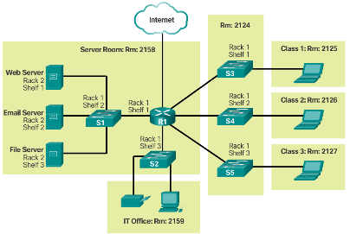
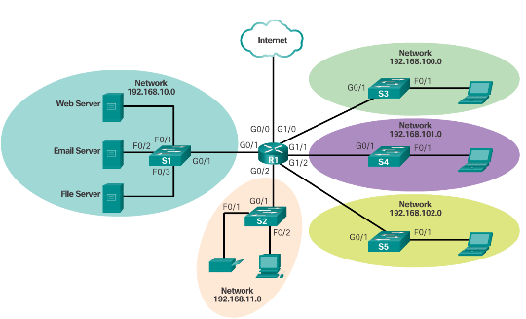
LANs, WANs, and the Internet Network Components
Physical Topology
Topology Diagrams
Physical - Identify the physical location of intermediary devices and cable installation.
Logical - Identify devices, ports, and addressing scheme.
Logical Topology
Notes:
1.2 – LANs, WANs, and the Internet
1.2.1 – Network Components

Slide 17
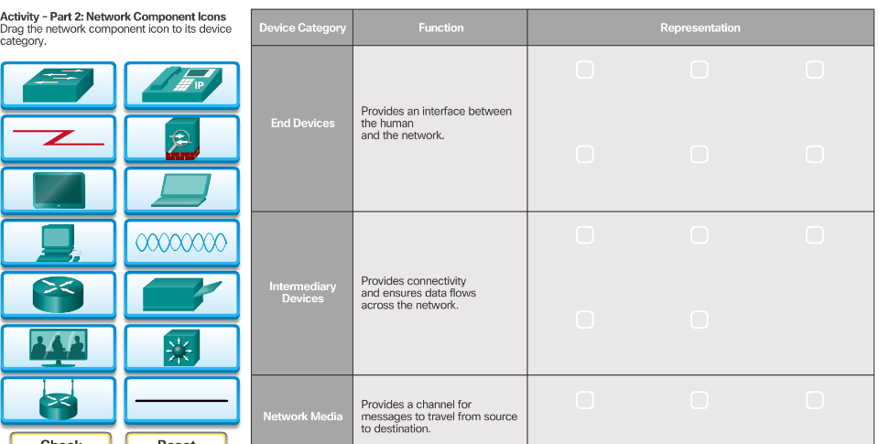
LANs, WANs, and the Internet Network Components
Notes:
1.2 – LANs, WANs, and the Internet
1.2.1 – Network Components

Slide 18
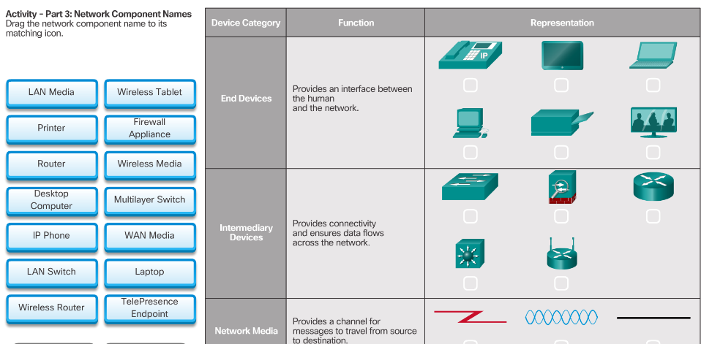
LANs, WANs, and the Internet Network Components
Notes:
1.2 – LANs, WANs, and the Internet
1.2.1 – Network Components

Slide 19
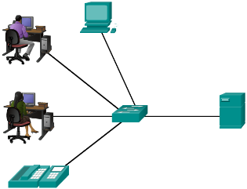
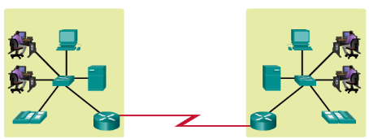
LANs, WANs, and the Internet LANs and WANs
Local Area Networks
Spans across small geographical area
Interconnects end devices
Administrated by a single organization
Provide high speed bandwidth to internal devices
WAN Area Networks
Interconnects LAN
Administrated by multiple service providers
Provide slower speed links between LANS
Can you name more network types?
Notes:
1.2 – LANs, WANs, and the Internet
1.2.2 – LANs and WANs

Slide 20
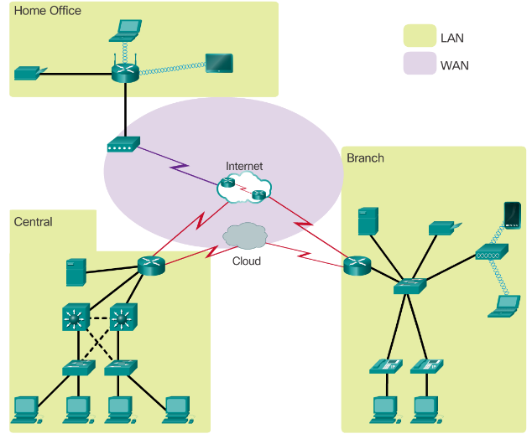
LANs, WANs, and the Internet LANs and WANs
Notes:
1.2 – LANs, WANs, and the Internet
1.2.2 – LANs and WANs

Slide 21
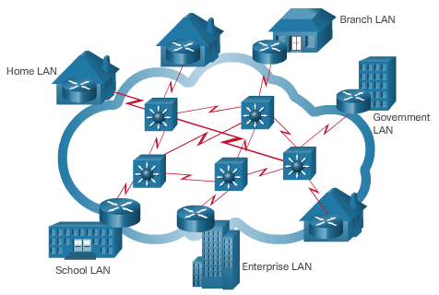
LANs, WANs, and the Internet The Internet, Intranets, and Extranets
The Internet
Worldwide collection of interconnected networks (of LANs and WANs)
Not owned by any individual or group
Notes:
1.2 – LANs, WANs, and the Internet
1.2.3 – The Internet, Intranets, and Extranets

Slide 22
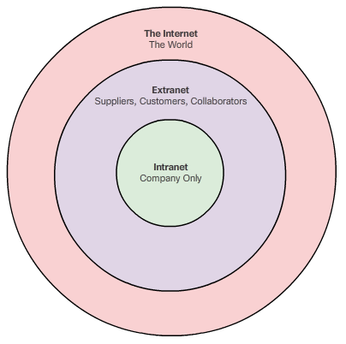
LANs, WANs, and the Internet The Internet, Intranets, and Extranets
Intranets – refer to a private connection of LANs and WANs that belongs to an organization, and is designed to be accessible only by the organization's members, employees, or others with authorization.
Extranets - provide secure and safe access to individuals who work for a different organization, but require access to the organization’s data.
Notes:
1.2 – LANs, WANs, and the Internet
1.2.3 – The Internet, Intranets, and Extranets

Slide 23
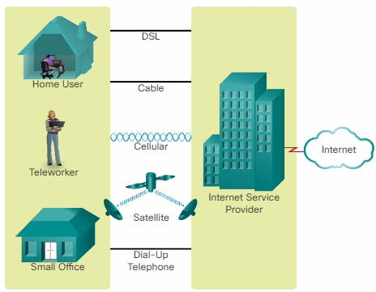
LANs, WANs, and the Internet Internet Connections
Internet Access Technologies
Internet Service Provider (ISP)
Broadband cable
Broadband Digital Subscriber Line (DSL)
Wireless WANs
Mobile Services
Business DSL
Leased Lines
Metro Ethernet
Types of Internet Connections
Home and Small Office
Business
Notes:
1.2 – LANs, WANs, and the Internet
1.2.4 – Internet Connections

Slide 24
LANs, WANs, and the Internet Internet Connections – Home & Small Office
Notes:
1.2 – LANs, WANs, and the Internet
1.2.4 – Internet Connections

Slide 25
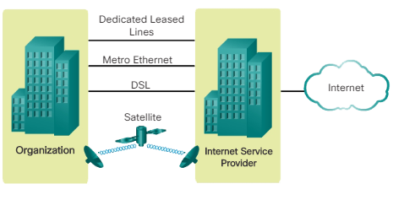
LANs, WANs, and the Internet Internet Connections – Business
Notes:
1.2 – LANs, WANs, and the Internet
1.2.4 – Internet Connections

Slide 26
Globally Connected Packet Tracer – Lab Activity 1.1 and 1.2
1.1 Help & Navigation Tips
1.2 Network Representation
Notes:
1.1 – Globally Connected
1.1.1 – Network Today

Slide 27
1.3 The Network as a Platform
Notes:
Cisco Networking Academy Program
Introduction to Networks v6.0
Chapter 1: Explore the Network

Slide 28
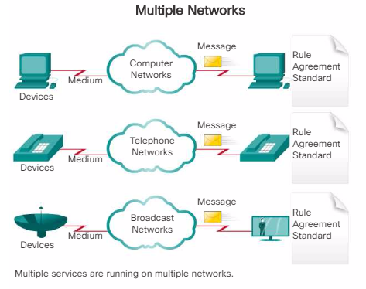
The Network as a Platform Converged Networks
Traditional Separate Networks
Each network with its own rules and
Notes:
1.3 – The Network as a Platform
1.3.1 – Converged Networks

Slide 29
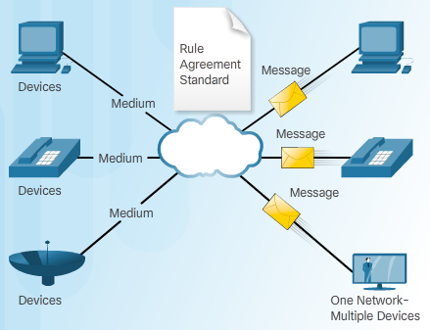
The Network as a Platform Converged Networks
The Converging Network
Capable of delivering data, voice, and video over the same network infrastructure
Notes:
1.3 – The Network as a Platform
1.3.1 – Converged Networks

Slide 30
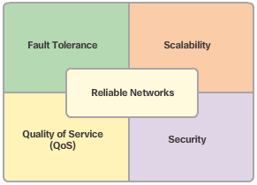
The Network as a Platform Reliable Network
Four Basic Characteristics of Network Architecture
Fault Tolerance
Scalability
Quality of Service (QoS)
Security
Notes:
1.3 – The Network as a Platform
1.3.2 – Reliable Network

Slide 31
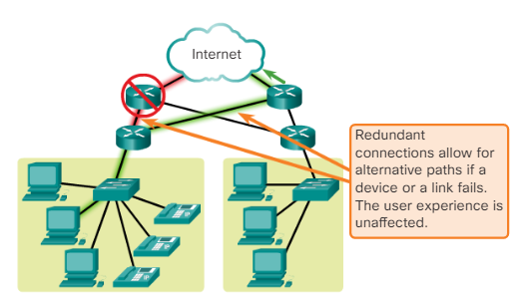
The Network as a Platform Reliable Network – Fault Tolerance
The expectation is that the Internet is always available to the millions of users who rely on it. This requires a network architecture that is built to be fault tolerant. A fault tolerant network is one that limits the impact of a failure, so that the fewest number of devices are affected. It is also built in a way that allows quick recovery when such a failure occurs.
These networks depend on multiple paths between the source and destination of a message. If one path fails, the messages can be instantly sent over a different link. Having multiple paths to a destination is known as redundancy.
Modern networks uses packet switch instead of circuit switch.
Packet switching splits traffic into packets that are routed over a shared network. A single message, such as an email or a video stream, is broken into multiple message blocks, called packets.
Notes:
1.3 – The Network as a Platform
1.3.2 – Reliable Network

Slide 32
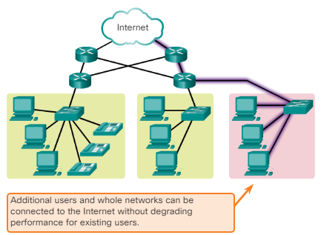
The Network as a Platform Reliable Network – Scalability
A scalable network can expand quickly to support new users and applications without impacting the performance of the service being delivered to existing users.
Notes:
1.3 – The Network as a Platform
1.3.2 – Reliable Network

Slide 33
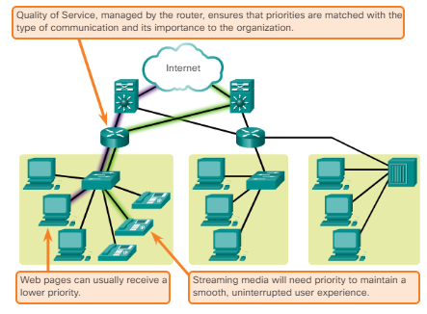
The Network as a Platform Reliable Network – Quality of Service
Quality of Service (QoS) is also an ever increasing requirement of networks today. New applications available to users over internetworks, such as voice and live video transmissions, create higher expectations for the quality of the delivered services. Have you ever tried to watch a video with constant breaks and pauses? As data, voice, and video content continue to converge onto the same network, QoS becomes a primary mechanism for managing congestion and ensuring reliable delivery of content to all users.
Congestion occurs when the demand for bandwidth exceeds the amount available. Network bandwidth is measured in the number of bits that can be transmitted in a single second, or bits per second (bps).
Notes:
1.3 – The Network as a Platform
1.3.2 – Reliable Network

Slide 34
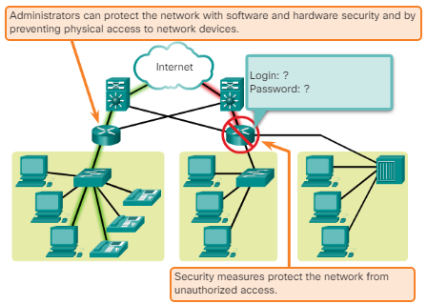
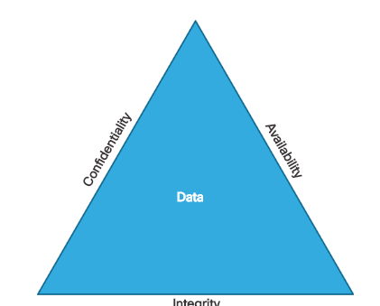
The Network as a Platform Reliable Network – Security
The network infrastructure, services, and the data contained on network-attached devices are crucial personal and business assets. There are two types of network security concerns that must be addressed: network infrastructure security and information security.
Securing a network infrastructure includes the physical securing of devices that provide network connectivity, and preventing unauthorized access to the management software that resides on them. Information security refers to protecting the information contained within the packets being transmitted over the network and the information stored on network attached devices.
To achieve information security, you need three things:
Notes:
1.3 – The Network as a Platform
1.3.2 – Reliable Network

Slide 35
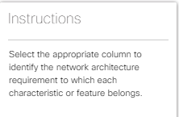
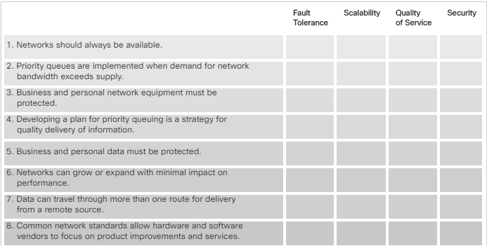
The Network as a Platform Reliable Network – End-of-Segment Checkup
Notes:
1.3 – The Network as a Platform
1.3.2 – Reliable Network

Slide 36
1.4 The Changing Network Environment
Notes:
Cisco Networking Academy Program
Introduction to Networks v6.0
Chapter 1: Explore the Network

Slide 37
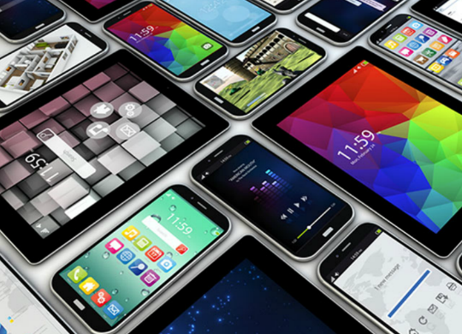
The Changing Network Environment Network Trends
Top trends include:
Bring Your Own Device (BYOB)
Online Collaboration
Video Communications
Cloud Computing
Notes:
1.4 – The Changing Network Environment
1.4.1 – Network Trends

Slide 38
The Changing Network Environment Network Trends – Bring Your Own Device
The concept of any device, to any content, in any manner, is a major global trend that requires significant changes to the way devices are used. This trend is known as Bring Your Own Device (BYOD).
BYOD is about end users having the freedom to use personal tools to access information and communicate across a business or campus network.
Notes:
1.4 – The Changing Network Environment
1.4.1 – Network Trends

Slide 39
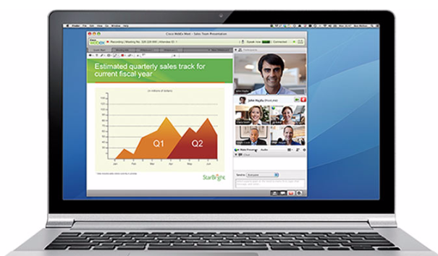
The Changing Network Environment Network Trends – Online Collaboration
Individuals want to connect to the network, not only for access to data applications, but also to collaborate with one another. Collaboration is defined as “the act of working with another or others on a joint project.” Collaboration tools, like Cisco WebEx shown in the figure, give employees, students, teachers, customers, and partners a way to instantly connect, interact, and achieve their objectives.
Notes:
1.4 – The Changing Network Environment
1.4.1 – Network Trends

Slide 40
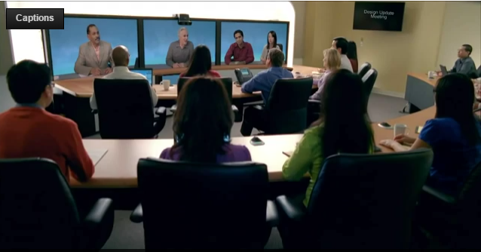
The Changing Network Environment Network Trends – Video Communications
Another trend in networking that is critical to the communication and collaboration effort is video. Video is being used for communications, collaboration, and entertainment. Video calls can be made to and from anywhere with an Internet connection.
Video conferencing is a powerful tool for communicating with others at a distance, both locally and globally
Notes:
1.4 – The Changing Network Environment
1.4.1 – Network Trends

Slide 41
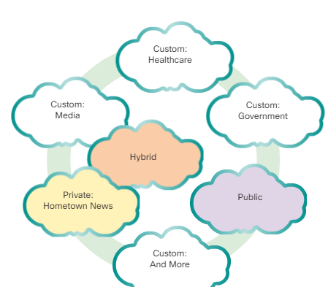
The Changing Network Environment Network Trends – Cloud Computing
Cloud computing is another global trend changing the way we access and store data. Cloud computing allows us to store personal files, even backup our entire hard disk drive on servers over the Internet. Applications such as word processing and photo editing can be accessed using the Cloud.
For businesses, Cloud computing extends IT's capabilities without requiring investment in new infrastructure, training new personnel, or licensing new software. These services are available on demand and delivered economically to any device anywhere in the world without compromising security or function.
Notes:
1.4 – The Changing Network Environment
1.4.1 – Network Trends

Slide 42
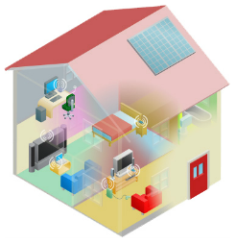
The Changing Network Environment Networking Technologies for the Home
Technology Trends in the Home
Smart home
Powerline Networking
Uses existing electrical wiring to connect devices
Wireless Broadband
Wireless Internet Service Provider (WISP)
Wireless Broadband Service using cellular technology
Notes:
1.4 – The Changing Network Environment
1.4.2 - Networking Technologies for the Home

Slide 43
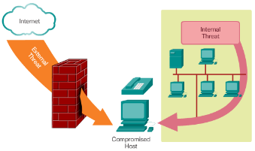
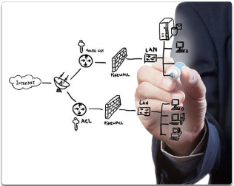
The Changing Network Environment Network Security
Security Threats
Viruses, worms, and Trojan horses
Spyware and adware
Zero-day attacks, also called zero-hour attacks
Hacker attacks
Denial of service attacks
Data interception and theft
Identity theft
Security Solutions
Antivirus and antispyware
Firewall filtering
Dedicated firewall systems
Access control lists (ACL)
Intrusion prevention systems (IPS)
Virtual Private Networks (VPNs)
Notes:
1.4 – The Changing Network Environment
1.4.3 – Network Security

Slide 44
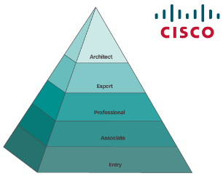
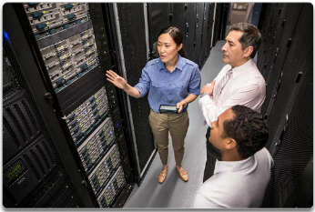
The Changing Network Environment Network Architecture
Cisco Network Architecture
Support technologies and applications
Ensure connectivity across any combination of networks
CCNA
A first step to a networking career
Notes:
1.4 – The Changing Network Environment
1.4.4 – Network Architecture

Slide 45
1.5 Chapter Summary
Notes:
Cisco Networking Academy Program
Introduction to Networks v6.0
Chapter 1: Explore the Network

Slide 46
Chapter Summary Summary
Explain how multiple networks are used in everyday life.
Describe the topologies and devices used in a small to medium-sized business network.
Explain the basic characteristics of a network that supports communication in a small to medium-sized business.
Explain trends in networking that will affect the use of networks in small to medium-sized businesses.
Notes:
1.5.1.3 - Summary

Slide 49
Section 1.1 New Terms and Commands
client
collaborative learning spaces
global communities
human network
network collaboration services
network of networks
peer-to-peer network
server
Notes:
New Terms and Commands

Slide 50
Section 1.2 New Terms and Commands
broadband cable
broadband DSL
business DSL
cable
cellular
dedicated leased line
dial-up telephone
DSL
end devices
extranet
hardware
intermediary devices
internetworking devices
Internet Service Provider (ISP)
Intranet
leased lines
Local Area Network (LAN)
logical topology diagrams
medium
Metropolitan Area Network (MAN)
metro Ethernet
network access devices
network interface card (NIC)
network media
physical port, interface
physical topology diagrams
satellite
security devices
service provider (SP)
software
Storage Area Network (SAN)
TelePresence endpoint
teleworkers
topology diagram
VoIP phones
Wide Area Network (WAN)
Wireless LAN (WLAN)
Notes:
New Terms and Commands

Slide 51
Section 1.3 New Terms and Commands
availability
circuit switched networks
content security
converged network
data confidentiality
data integrity
delay
Denial of Service (DoS)
encrypting data
fault tolerance
hierarchical layered structure
intelligent information network
network architecture
network bandwidth
network congestion
network infrastructure security
packet loss
packet switched networks
packets
Quality of Service (QoS)
queue
redundancy
routing function
scalability
user authentication
Notes:
New Terms and Commands

Slide 52
Section 1.4 New Terms and Commands
access control lists (ACL)
adware
Bring Your Own Deice (BYOD)
cloud computing
data centers
data interception and theft
hacker attacks
identity theft
intrusion prevention systems (IPS)
multiple layers of security
multitasking
online collaboration
person-to-person video calling
powerline networking
server clusters
server farms
smart home technology
spyware
Trojan horses
video conferencing
virtual private networks (VPNs)
virtualization
viruses
wireless broadband service
wireless internet service provider (WISP)
wireless local area networks (WLAN)
worms
zero-day attacks
Notes:
New Terms and Commands

